Slide 1
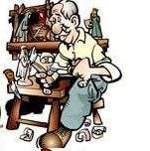

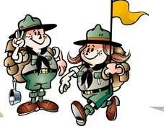
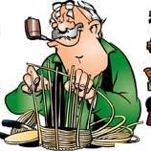

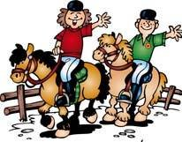
HOBBY

Slide 2
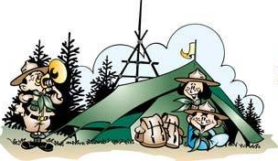
Hobby is occupation, which is done not for money, but for pleasure. Different people get pleasure from doing different things, as very person has his/her own likes and dislikes.

Slide 3



People choose their hobbies according to their likes and dislikes, tastes, style, their financial state and education.

Slide 4


Hobby can be divided into four groups : art, collecting, handicrafts, games and sport

Slide 5



There are such art forms, as dancing, drama, painting, graphic art, and music.

Slide 6
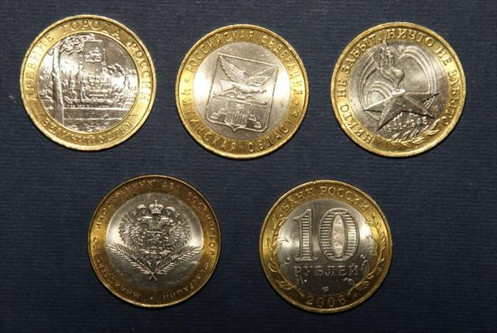
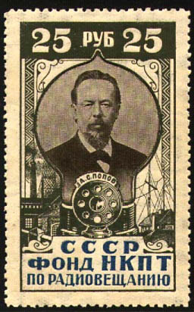
The most popular hobby groups is collecting things, because almost everyone collect something at some period in his life stamps, coins, matchboxes, records, post cards, toys etc.
But sometimes in can be very expensive. For example, if you collect some rare and valuable coins or some original paintings (pictures).

Slide 7
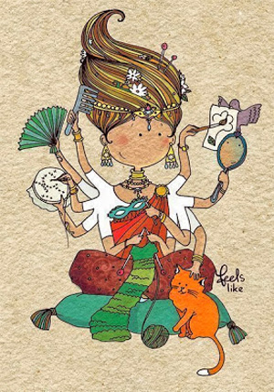
Handicraft attract hobbyists who can work skillfully with their hands. Many of them are engaged in needlework activities, crocheting, knitting, and sewing.

Slide 8

Games and sports are popular with many hobbyists who enjoy competition, physical activity, and exercise. Thousand of hobbyists take part in sports, such as bowling, fishing, mountain climbing, skiing, and tennis. Popular indoor games include card games, chess.
Many people, especially children, play computer games.

Slide 9
thank you for your attention

